Slide 1
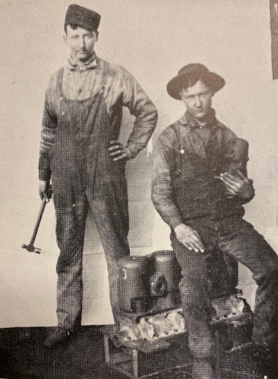
100 Years Since Johnson Outboards Were Born
By: Ken Kirk Images from Ken Kirk Collection
It has been 100 years since the Johnson brothers introduced their first outboard motor at the 1922
New York Boat Show. Through more than 85 years the Johnson brand had been a major player in the outboard industry until its final year of production, 2007.
The Johnson brothers started building marine motors in 1903 when Lou Johnson designed and supervised the casting and assembly of a single cylinder, 2 cycle marine engine, developing about 3 HP. Lou had no formal education as an engineer but his father, Soren, was a skilled tool dresser and blacksmith. Together with his fathers guidance and the enthusiastic help of his younger brothers, Harry, Julius and Clarence, they built this inboard marine engine to power the families 18 ft rowboat for their own personal pleasure on the Wabash River at Terre Haute, Indiana.
The success of their first marine motor led to the inevitable build of a larger, more powerful and faster motor. One success led to another and by 1905 they were building and selling a line of 1, 2 & 4 cylinder,
2 cycle, marine inboard engines.
They had been building engines in a barn behind the family home but by 1908 they moved to a proper factory on the south side of Terre Haute and formally organized as the Johnson Brothers Motor Company.
Lou Johnson was driven to design and build lighter weight, more powerful engines for speed boats.
Harry & Julius Johnson, 1908
He also saw the emerging need for lightweight motors to power the double winged biplanes that were starting to be built in Europe and the United States by the Wright Brothers and others. By 1909 the Johnson Brothers had developed a 4 cylinder, water cooled engine for high speed marine use and for aircraft. By 1911 they offered lightweight 4, 6, 8 and12 cylinder motors for both marine and aerial use. The 12 cylinder developed 180 HP.
Cont’d pg. 8
Johnson Brothers Motor Co. 12 Cylinder V Type Motor – 180 HP
Page 7

Slide 2
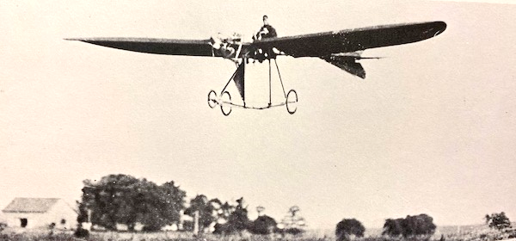
100 Years Since Johnson Outboards Were Born
Cont’d
The Johnson’s 32’ Step Hydroplane, Black-Demon III, powered by two 180 HP, V-12 Johnson Inboards.
To promote these powerful new lightweight Johnson Motors, they did two things. For the marine application they built a 23 ft single step hydroplane and powered it with two V 12 Johnson engines producing 180 HP each. The Boat, Black-Demon III,
Lou Johnson in 1929.
Born 1881-Died 1963
was never beaten in a race according to the Johnson family archives. Other reports say she lost only once. The second initiative, led by Lou Johnson, was the most visionary of all. To promote the Johnson Aerial Motor, Lou designed and built his own airplane, a single winged monoplane. After trial and error with his first design in 1910, the second design was a great success. On August 11, 1911, Lou Johnson made aeronautical history with the first successful flight of a monoplane in the U.S..
The Johnson monoplane had a single wing span of 36 ft, was 34 ft long and weighed 750 lbs. It also had a new style tricycle landing gear also designed by Lou.
Cont’d pg. 9
Lou Johnson flying his Johnson designed & built Monoplane, August 1911.
The first successful Monoplane built in the U.S.A
Page 8

Slide 3
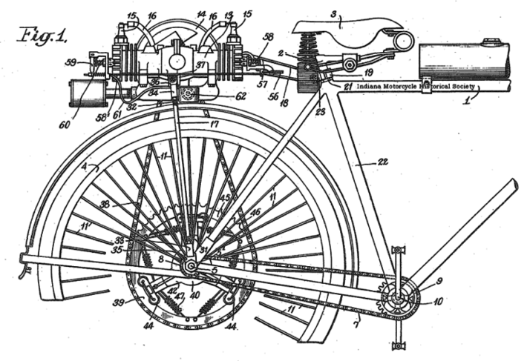
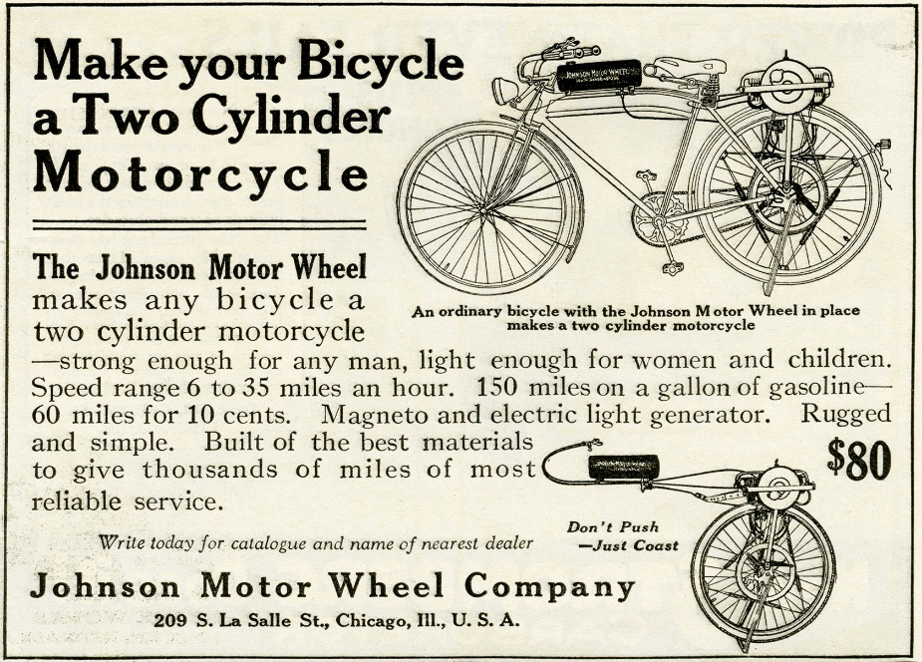
100 Years Since Johnson Outboards Were Born
Cont’d
The Johnson Brothers Motor Company was not only making money from sales of their marine and airplane motors but also from barnstorming and exhibition fees and successfully competing with their monoplane. Lou was the only Johnson to fly the plane but because of the high demand for barnstorming appearances an adventures
Ross Smith was hired and trained to fly to relieve Lou of some of his flying duties. This prompted the Johnsons to develop yet another profitable enterprise, the Johnson School of Aviation in Terre Haute.
In 1959 the Johnson brothers built a 1-10th scale model
of their monoplane, and its Aerial Motor. In July they presented their model to the National Air Museum division of the Smithsonian in Washington, D.C..
The Johnson brothers were flying high through
1911, 12 and 13. Then disaster struck. On Mar. 23, 1913, a tornado struck Terre Haute and was followed by the flooding of the Wabash River. The Johnson factory & offices were completely destroyed and everything was
lost including plans, drawings, patterns as well as engine inventory and manufacturing equipment. A total loss.
With no insurance and little capital the Johnson brothers were suddenly out of business.
The brothers engaged in various other activities to stay afloat. Julius who was a talented machinist, and had
been in charge of production, left the Company for more secure employment.
Patten drawing of Johnson Motor Wheel, opposed firing, two cycle, 2-cylinder Motor. This was the starting point for the later development of
the Johnson Model A Outboard.
In an effort to get back into the engine building business with limited resources, Clarence Johnson focused on the development of a small, lightweight, air cooled, opposed firing, 2 cylinder motor that could be used to power boats or bicycles. The bicycle application emerged as the most promising. By 1916 Clarence, with help from Lou and Harry, had built and tested four protypes. They had two problems. First, the magneto they were using was not producing a reliable spark at speed. Second, the brothers could not raise the capital required to get into any significant level of production.
Cont’d pg. 10
Clarence Johnson, 1895- 1976
Page 9

Slide 4
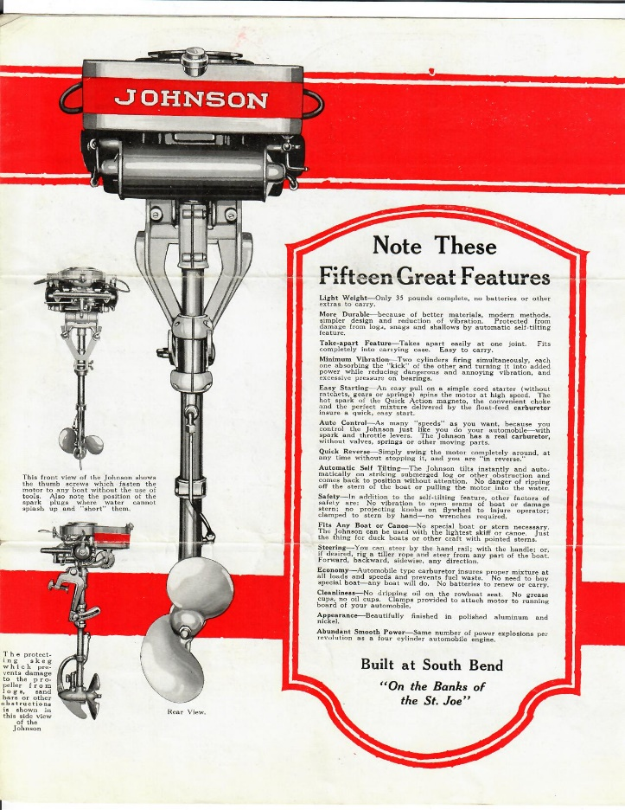
100 Years Since Johnson Outboards Were Born
Cont’d
The search for a superior magneto led to the connection of the Johnson brothers with the Quick Action Magneto Company and its President, Warren Ripple. The result was a partnership that would once again bring success for the Johnson brothers. Ripple brought business experience and financial capital to the enterprise. In early 1918 the Johnson Motor Wheel Co. was formed with Warren Ripple, President. The manufacturing operation was moved to South Bend Indiana. By 1920 they had sold over 17,000 Johnson Motor Wheels.
As part of this arrangement, Clarence, Lou and Harry Johnson, along with brother-in-law Warren Conover, formed the Johnson Brothers Engineering Company. They were the only four shareholders. This company held all of the design rights and patents registered by the Johnson bothers over the years. All future designs and patents attributed to and registered by the Johnson brothers also became the property of Johnson Bothers Engineering. The engineering company was paid royalties by the Johnson Motor Wheel Co. and subsequent corporate entities including the Johnson Motor Company, The Canadian Johnson Motor Company, The Outboard Motors Corp. and finally the Outboard Marine Corp.
The success of the Johnson Motor Wheel Company was relatively short lived. By 1921 there was strong competition in the motor wheel and motorcycle business and Henry Ford had also introduced his mass produced and affordable Model T. In 1921 Ripple and the Johnson brothers were losing money and decided to close the Johnson Motor Wheel business.
Now once again, back to the drawing board. Lou Johnson, still motivated by his interest in marine power, brought forward design drawings for the first Johnson outboard motor. With the continued financial backing of Warren Ripple, the Johnson Motor Company was incorporated with Ripple as President. Prototypes were built and tested, manufacturing organized and the first Johnson outboards came off the production line in South Bend Indiana, in Dec. 1921. The Johnson outboard was introduced to the public for the first time at the New York Boat Show in 1922.
Warren Ripple, first President of the
Johnson Motor Company.
Page from the first 1922 Johnson brochure
setting out the benefits of the Johnson
Light Twin, Model A Outboard.
Cont’d pg. 11
Page 10

Slide 5
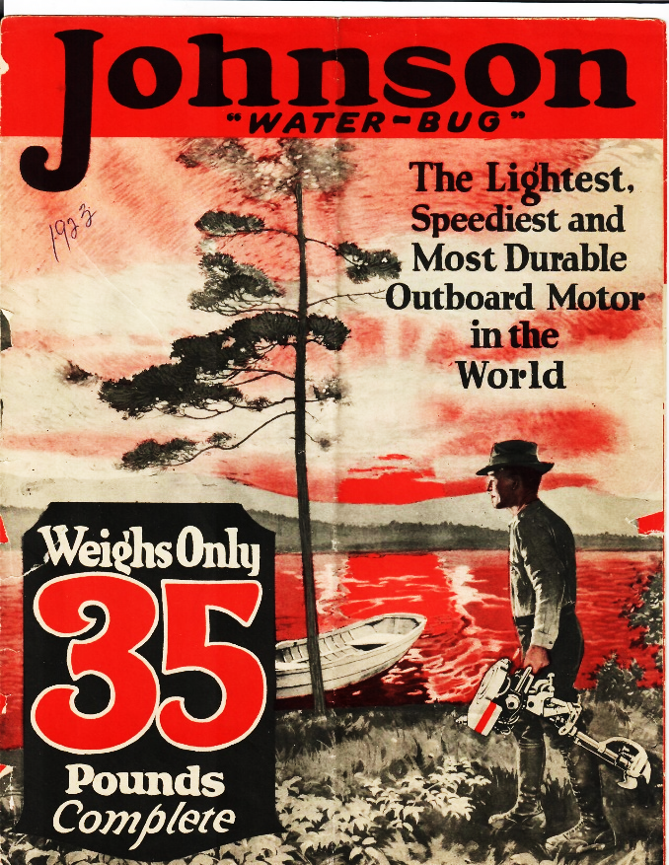
100 Years Since Johnson Outboards Were Born
Cont’d
The Johnson Model A entered an already crowded marketplace. There were more than 30 companies making an outboard motor. However most had followed the successful template established by Ole Evinrude in 1909 but there had been little design advancement since. They were mostly single cylinder, low RPM motors turning 700 to 900 RPM. They were heavy, 90 lbs. and more, being made primarily of cast iron and brass. They had either cumbersome battery ignition systems or unreliable flywheel magnetos. Few had a reliable reversing mechanism.
The Johnson Model A had many innovations and distinct advantages over other outboards in 1922. It weighed only 35 lbs. due to the use of aluminum alloy. Its two cylinder opposed firing configuration produced 2 horsepower at a smooth running 2200 RPM.
The flywheel magneto developed by Ripples Quick Action Magneto Company was waterproof and delivered easy reliable starting. No knuckle busting knobs.
The Johnson also had full pivot functionality which allowed it to turn 360 degrees on the back of the boat delivering maximum maneuverability and easy, reliable, reverse.
The only motor coming close was Ole Evinrude’s Elto Ruddertwin. First introduced in 1921, Ole had seen the advantage of lightweight aluminum alloy and opposed firing twin cylinder design. However, the Elto had a battery ignition and a fixed power head with independent rudder steering. Reverse was achieved by stopping the motor and restarting the motor so it would run backwards. The Johnson was a much more compact and user friendly set up.
The Johnson Model A was given the name “Waterbug” in advertising materials in 1922 & 23. Over 10,000 motors were sold in these first two years. The Johnson brothers were on their way to another great success, becoming an innovative and dominant brand in the
outboard industry.
We will continue to track the history of Johnson Outboards in the June Issue of the MLAOC Newsletter.
Reference Material for this article includes:
The Four Men From Terre Haute by J.M. Van Vleet
Evinrude, Johnson & The Legend of OMC by Jeffrey Rodengen
The Pictorial History of Outboard Motors by W. J. Webb
Front cover 1923 Johnson “Waterbug” brochure.
Page 11

